Slide 1

Machine Learning and Data Mining
Lecture 0.1: Introduction, Class Logistics, and Sources of Error

Slide 2
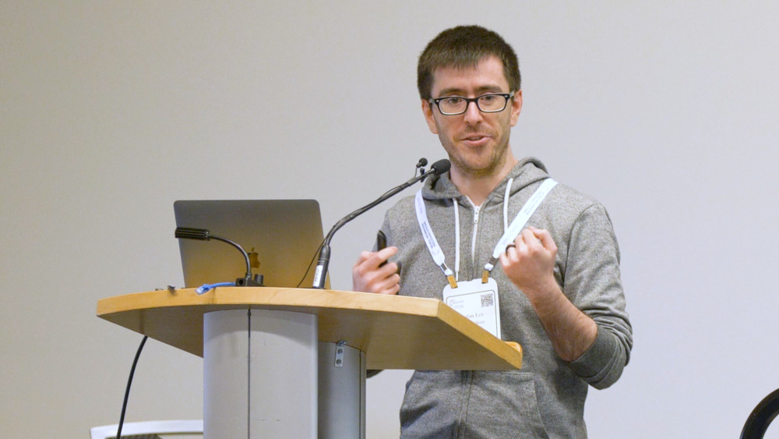

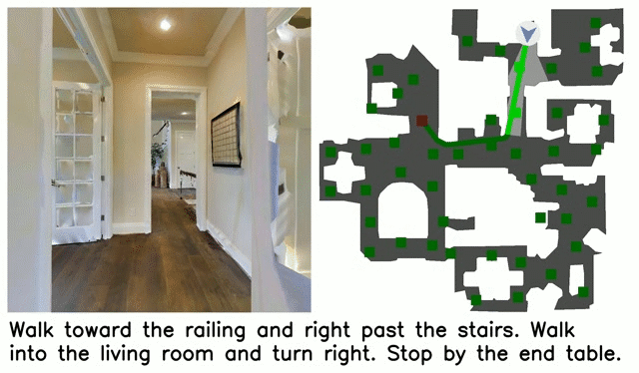
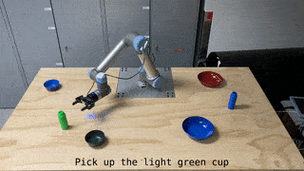
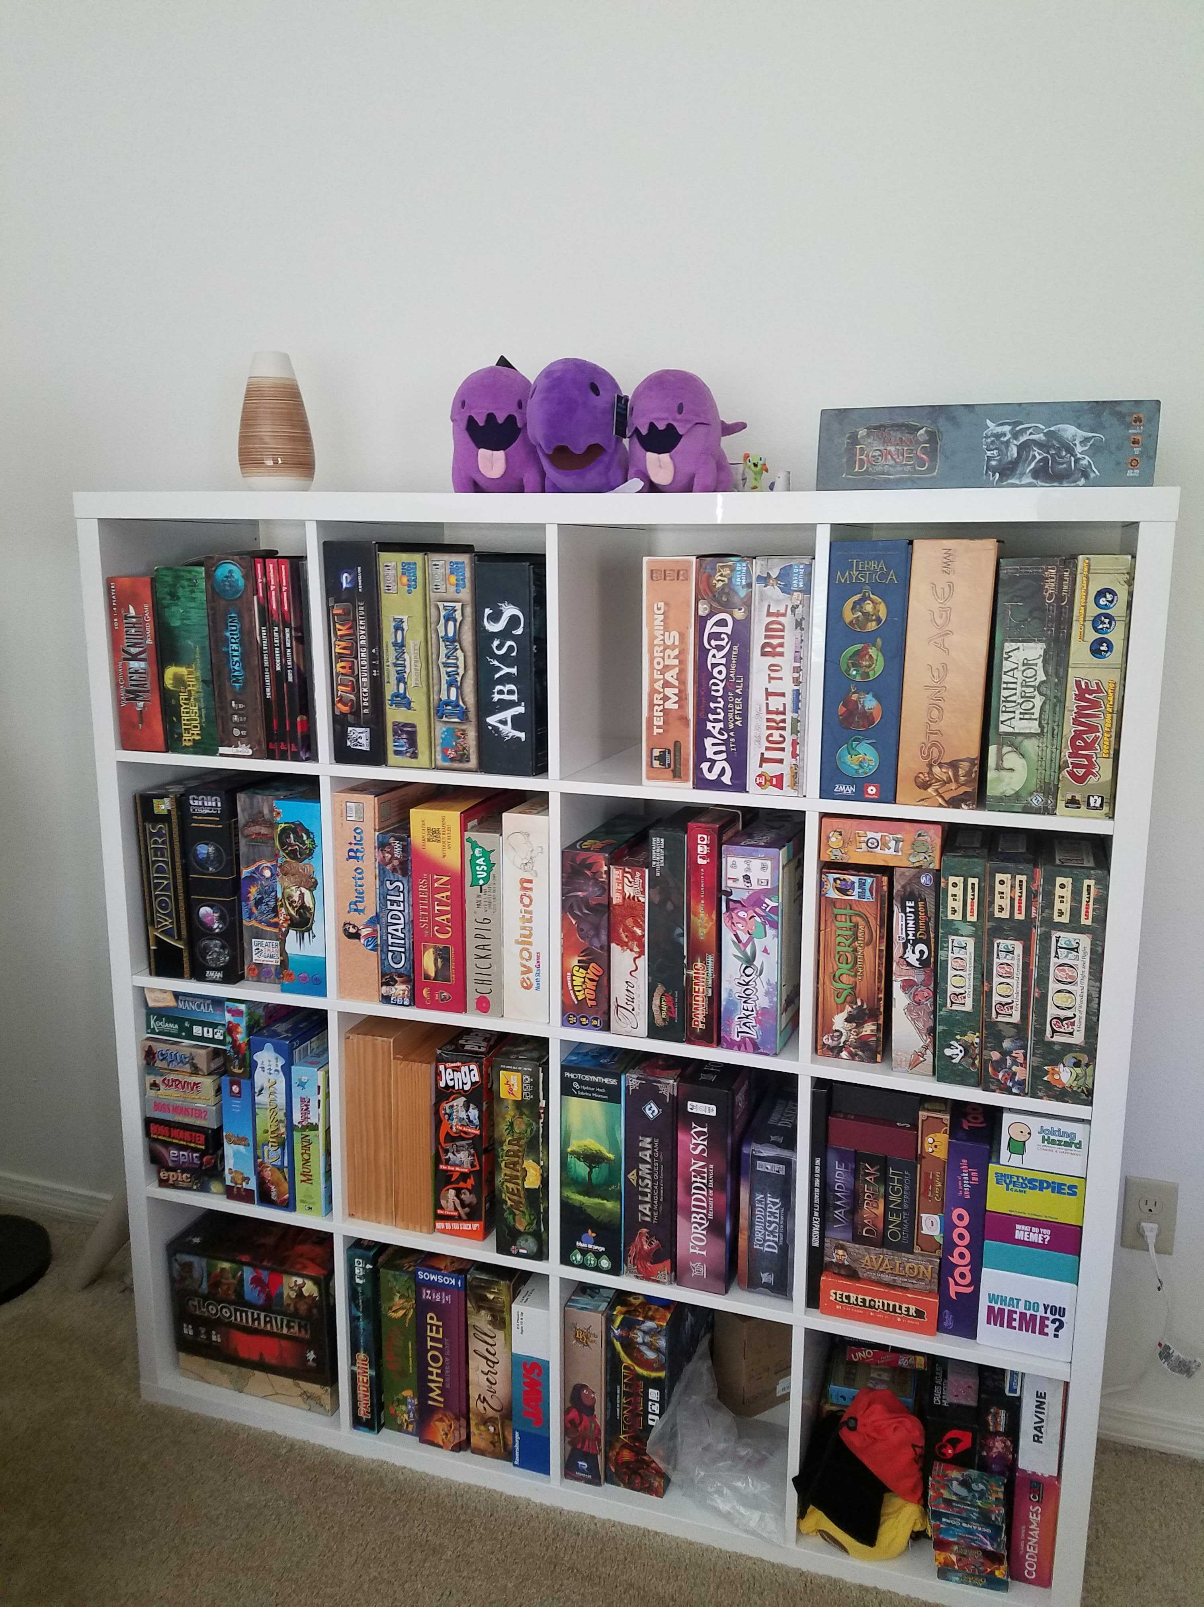
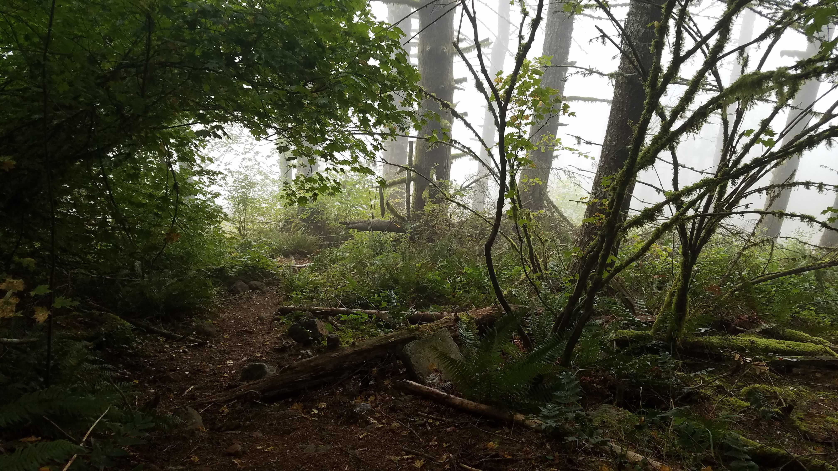
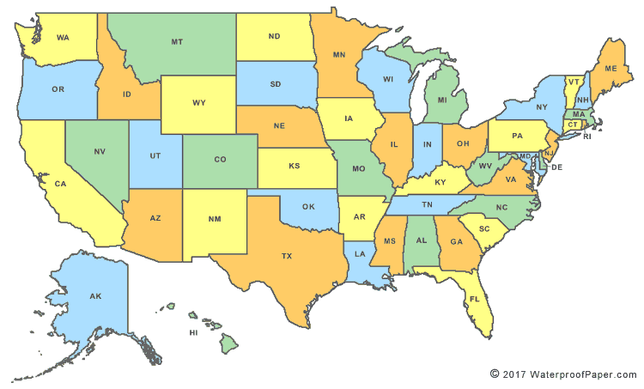
Who is this guy?
What I study
Me in my natural habitat
He/him/his
What I do for fun
Where I’m From

Slide 3
Be able to answer:
What is machine learning (ML)?
When is it appropriate to use?
How is this class structured?
How will I be assessed / graded?
How can I categorize different ML techniques?
What is the standard ML formalism?
Why must we make assumptions to learn?
What are sources of error in ML?
What is the idea behind k-nearest neighbors?

Slide 4

What is Machine Learning?
"Field of study that gives computers the ability to learn without being explicitly programmed”
- Arthur Samuel
“Any change in a system that allows it to perform better the second time on repetition of the same task or on another task drawn from the same distribution”
- Herbert Simon
“Algorithms that automatically detect patterns in data and use the uncovered patterns to predict future data or other outcomes of interest”
- Kevin Murphy
“Algorithms that improve their performance (P) at some task (T) with experience (E)”
- Tom Mitchell

Slide 5


What is Machine Learning? (Arthur Samuel’s Answer)
Traditional Programming
Data
Output
Program
Machine Learning
Data
Program
Output
"Field of study that gives computers the ability to learn without being explicitly programmed”
- Arthur Samuel

Slide 6
What is Machine Learning? (Tom Mitchell’s Answer)
Machine Learning
Task T
Performance P
Learning Algorithm
Experience E (Data)
“Algorithms that improve their performance (P) at some task (T) with experience (E)”
- Tom Mitchell

Slide 7
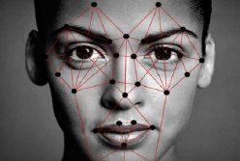
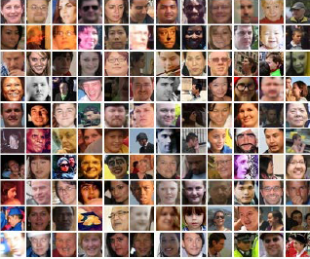
What is Machine Learning? (Tom Mitchell’s Answer)
Machine Learning
Task T
Performance P
What percent of faces are recognized correctly?
Learning Algorithm
Experience E (Data)

Slide 8
What is Machine Learning? (Relative to AI)
Artificial
Intelligence
Machine
Learning

Slide 9
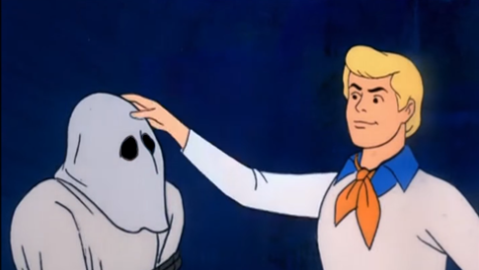
What is going on under the hood in Machine Learning?
Machine
Learning

Slide 10
What is going on under the hood in Machine Learning?
Calculus
Optimization
Applied Statistics
Linear Algebra
Programming

Slide 11
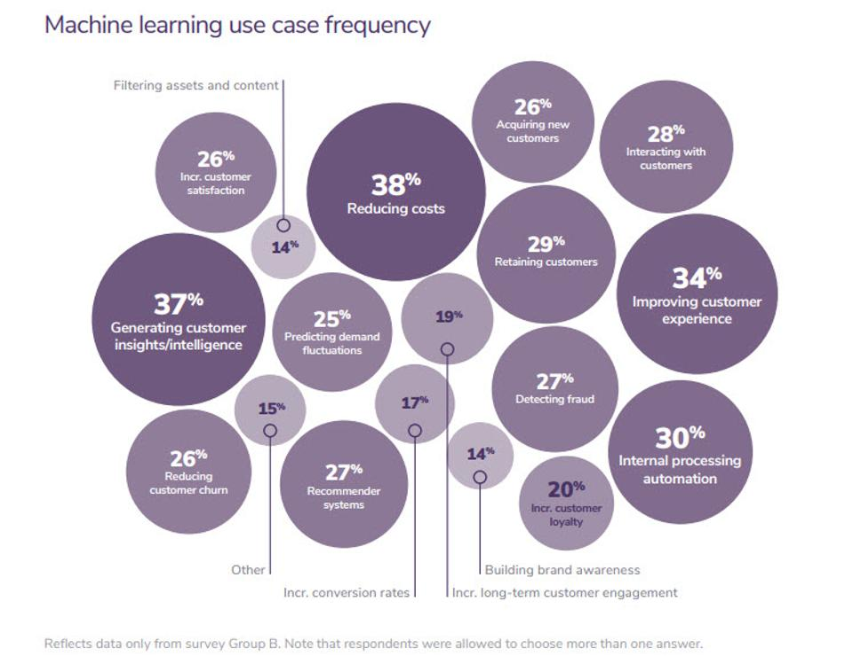
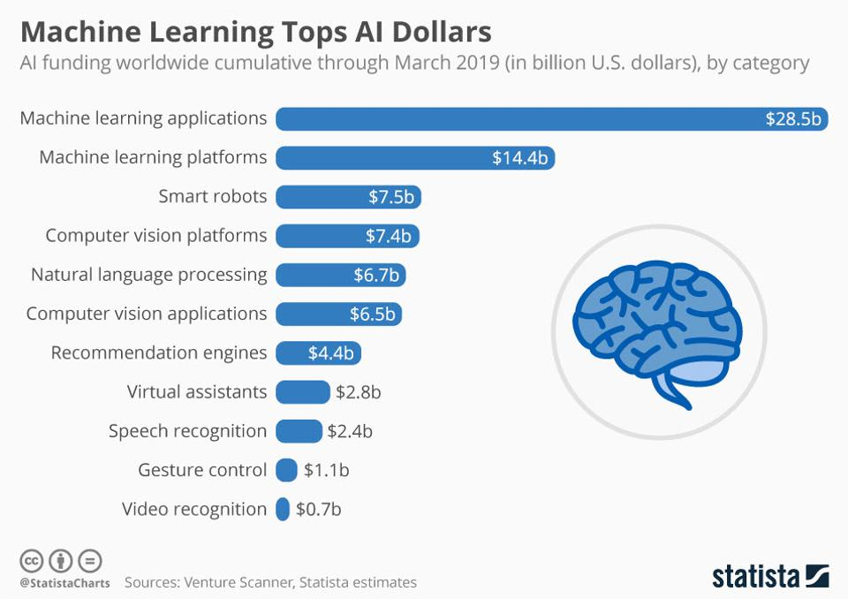
What is Machine Learning? (Relative to Business)

Slide 12
Where is Machine Learning used?
Machine learning is already the preferred approach to:
Speech recognition
Natural Language Processing
Computer Vision
Robotic Control
Recommender Systems
…
This trend is growing
Improved machine learning algorithms
Increased data capture and availability
Increased computing power
Increased demand for personalization to users and environments

Slide 13
When do we need learning?

Slide 14


When do we need learning?
1) Situations where humans can perform a task but can’t describe how programmatically.
Image Classification

Slide 15
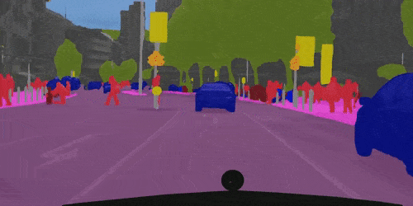
When do we need learning?
1) Situations where humans can perform a task but can’t describe how programmatically.
Video Segmentation

Slide 16



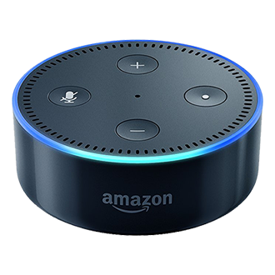
When do we need learning?
1) Situations where humans can perform a task but can’t describe how programmatically.
Play songs by The Mountain Goats
Speech Recognition

Slide 17
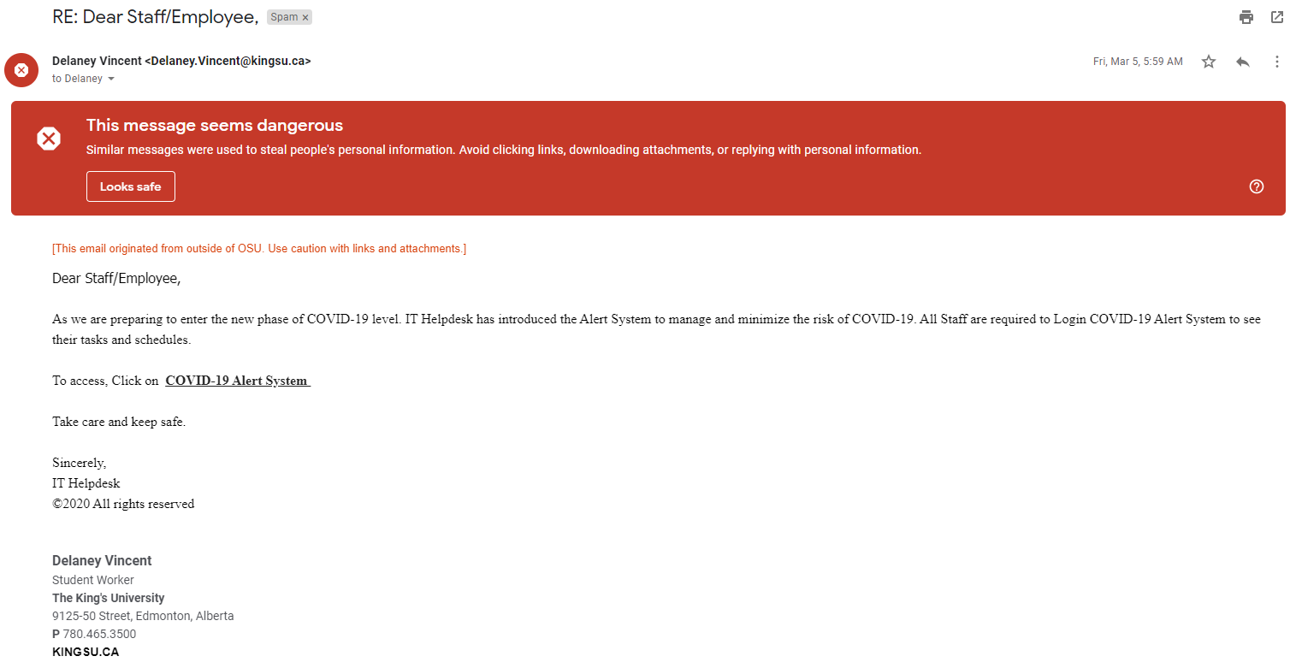

When do we need learning?
1) Situations where humans can perform a task but can’t describe how programmatically.
Spam Detection

Slide 18
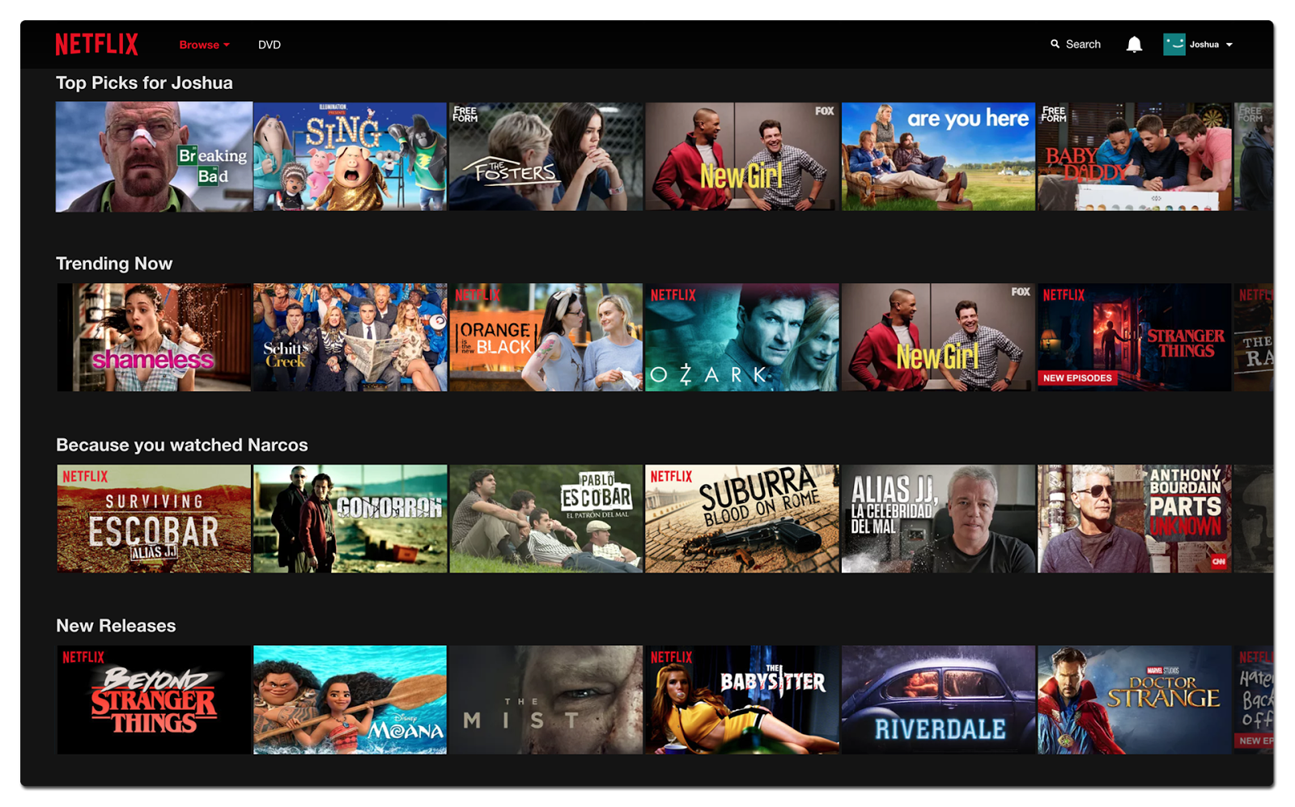
When do we need learning?
2) Situations where the desired function is different for each individual user
Recommendation Systems

Slide 19
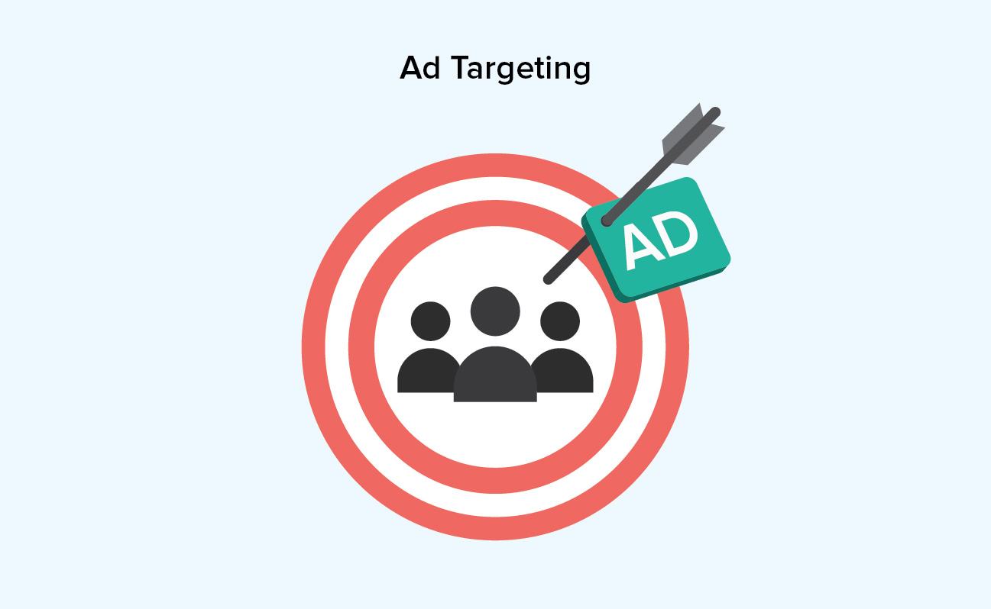
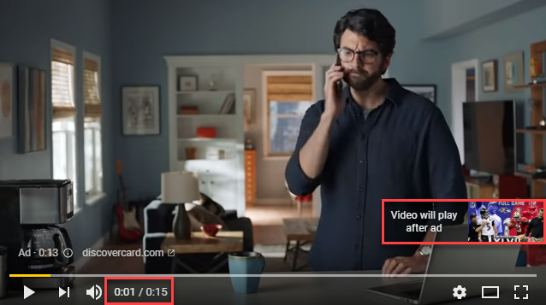
When do we need learning?
2) Situations where the desired function is different for each individual user
Ad Targeting

Slide 20
When do we need learning?
2) Situations where the desired function is different for each individual user
Can I ask who is speaking so I can better understand your voice in the future?
Personalization

Slide 21
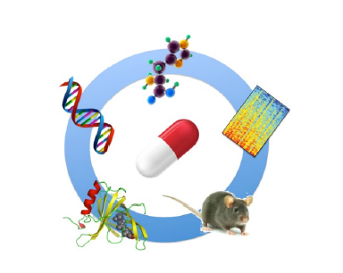
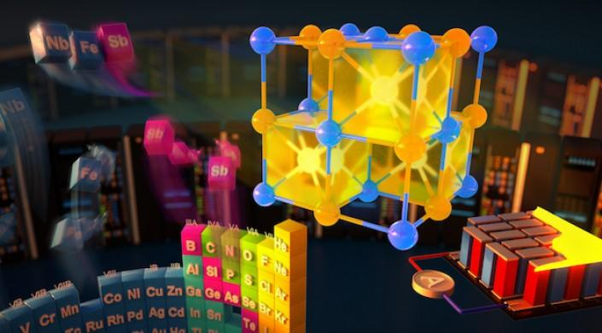
When do we need learning?
3) Situations where human experts do not have sufficient knowledge (or time)
Based on molecular structure, predict effect.
Drug / Material Discovery

Slide 22
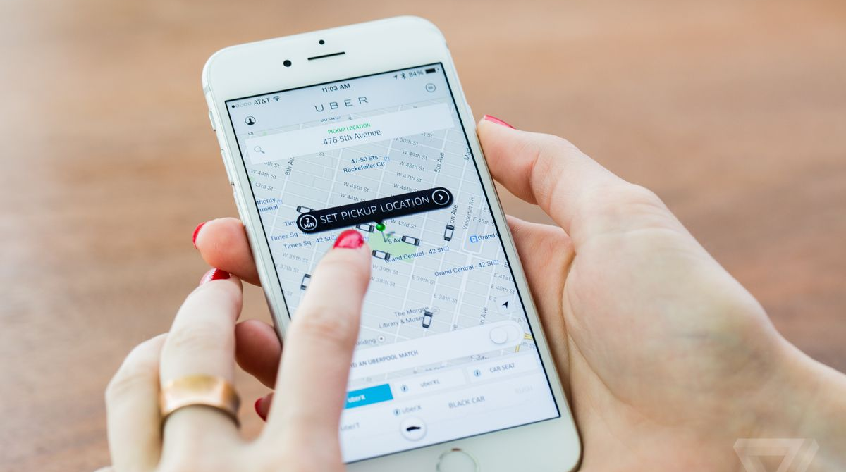
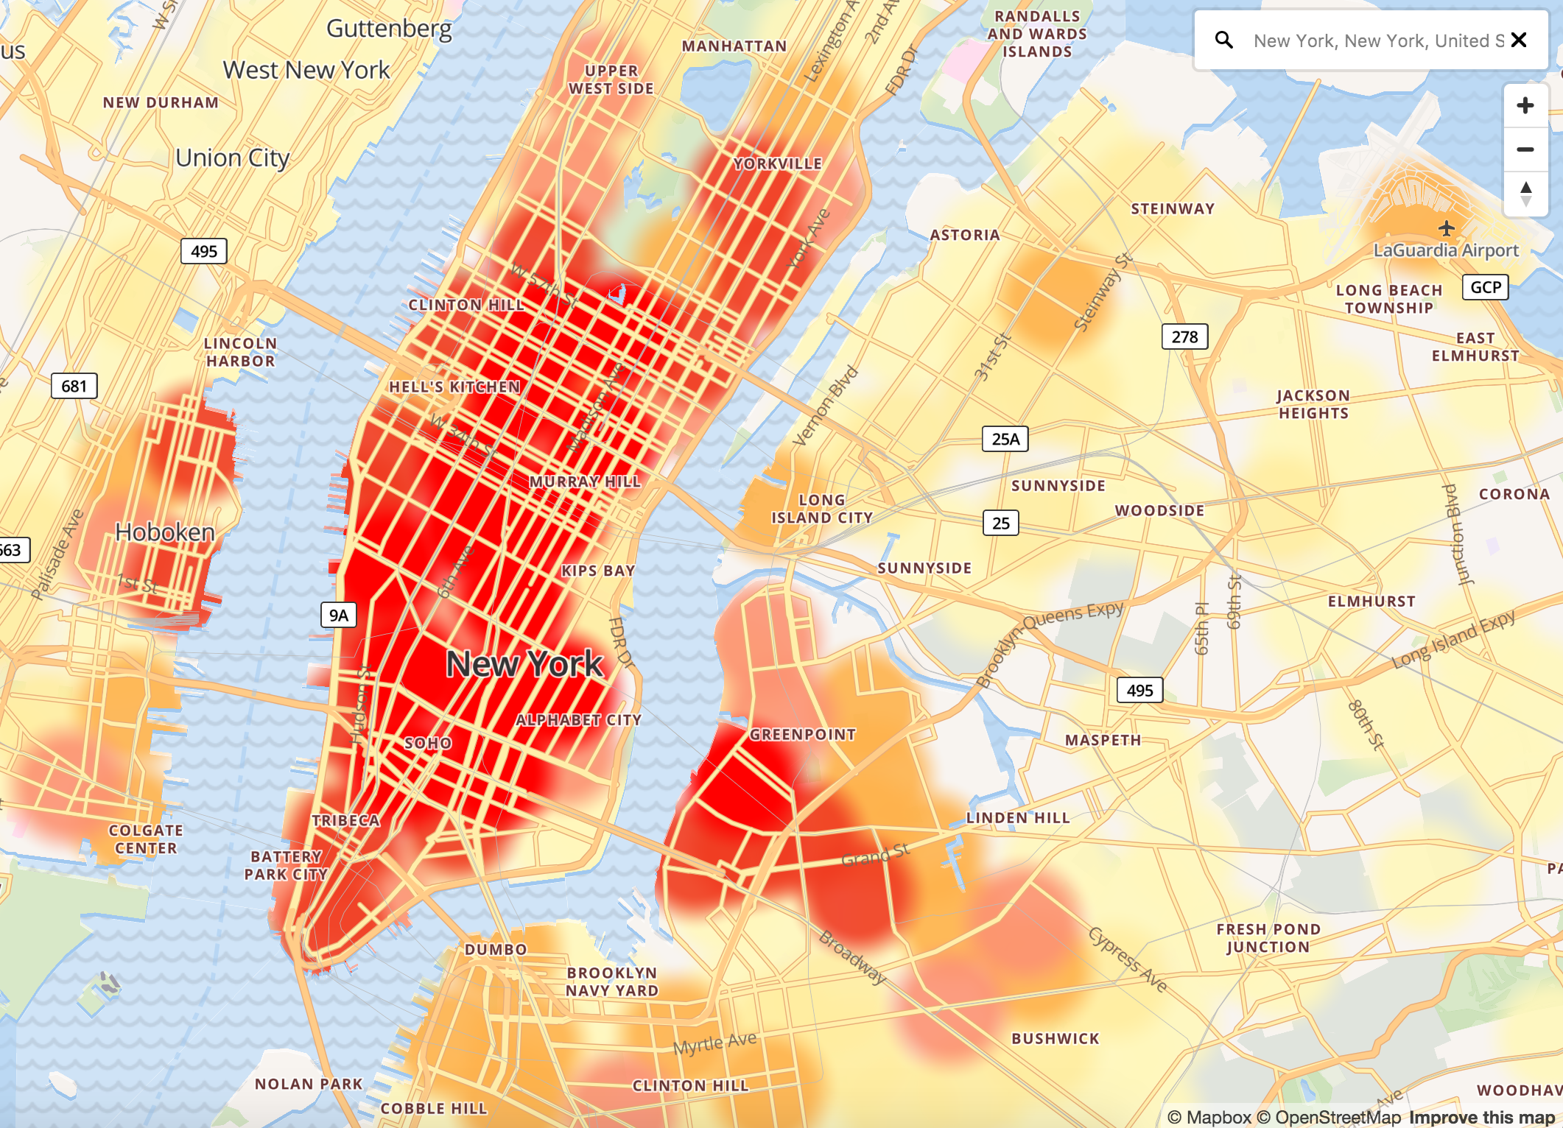
When do we need learning?
4) Situations where the function of interest is changing rapidly.
Anticipating Demand

Slide 23
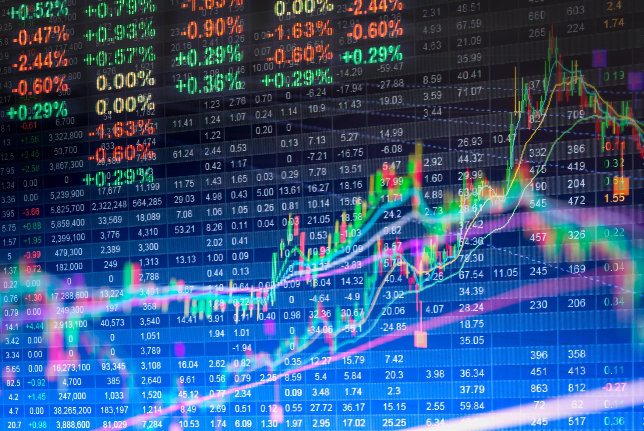

When do we need learning?
4) Situations where the function of interest is changing rapidly.
Predicting Stock Markets

Slide 24
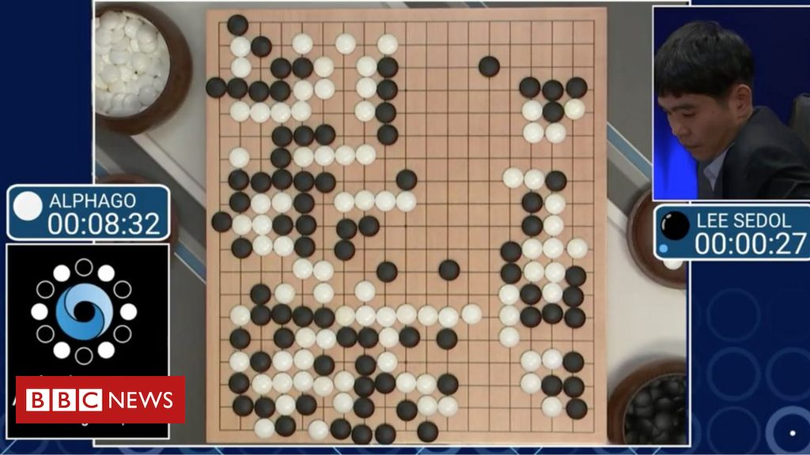

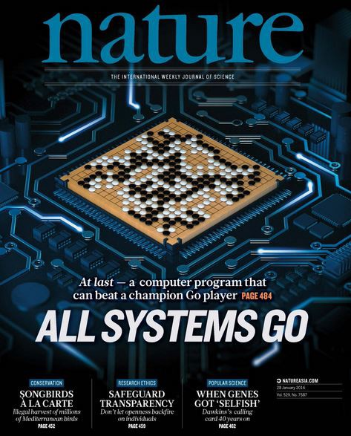
Recent Public Successes of Machine Learning

Slide 25
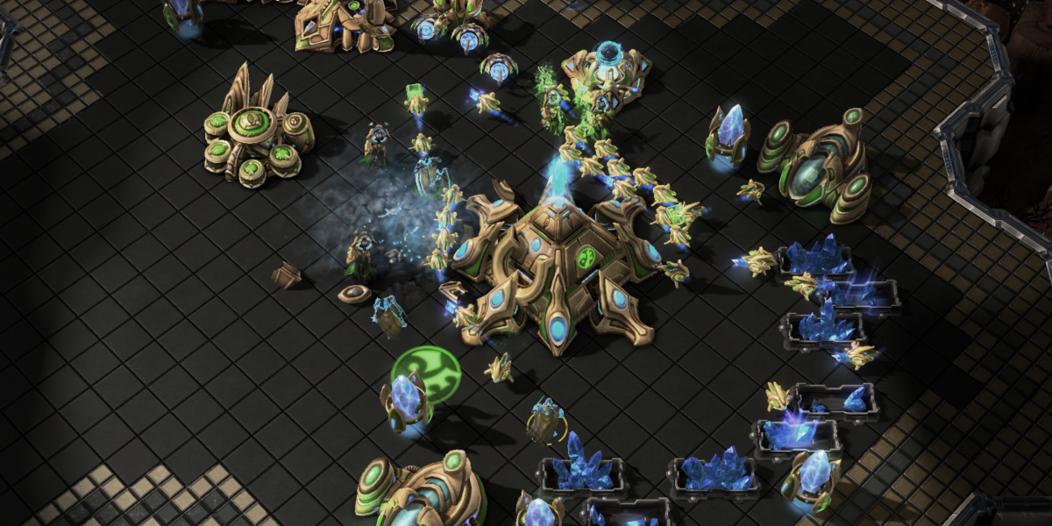
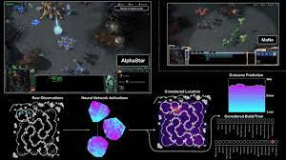

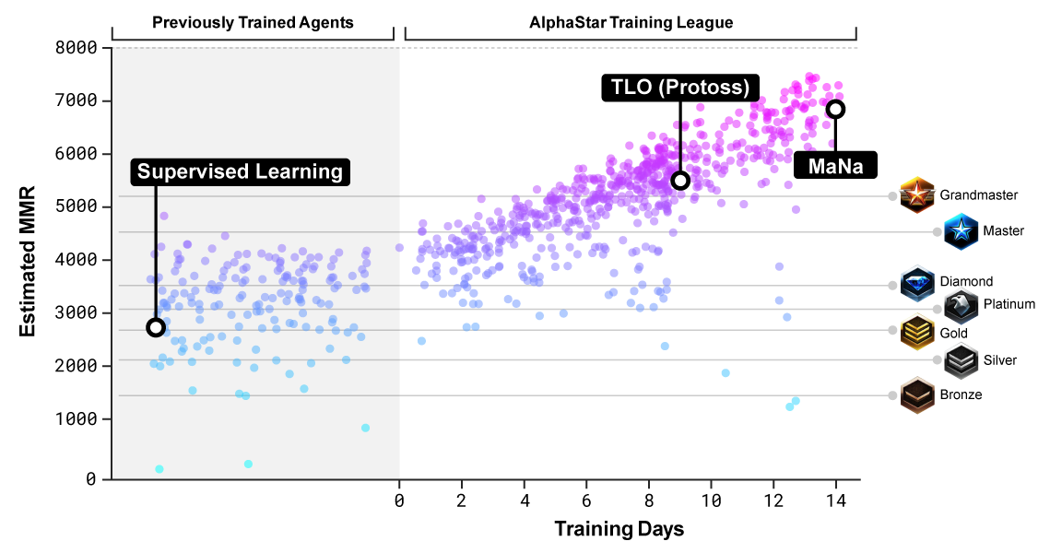

Recent Public Successes of Machine Learning
My Protoss

Slide 26
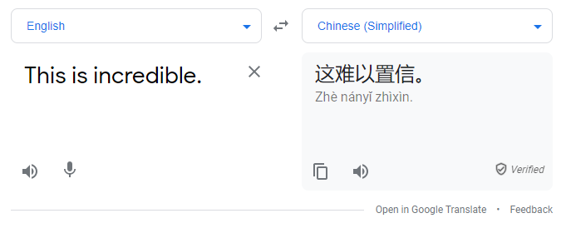
Recent Public Successes of Machine Learning
Google Translate is amazing. Not perfect, but amazing.

Slide 27

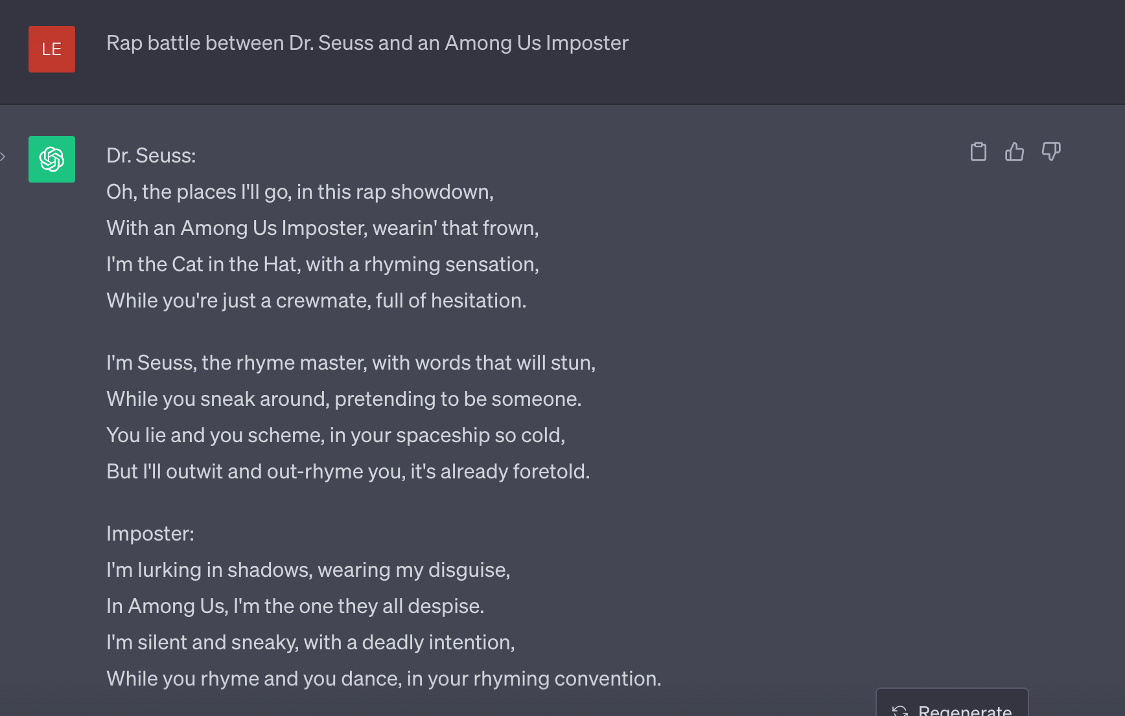
Recent Public Successes of Machine Learning

Slide 28
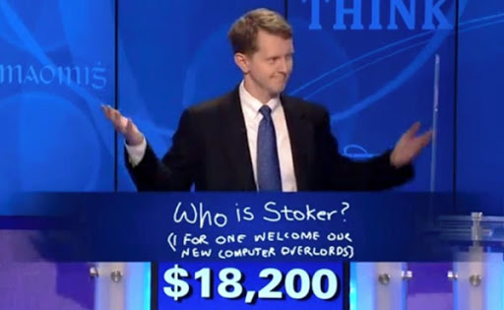
Recent Public Successes of Machine Learning
Ken Jennings Final Jeopardy Answer after losing to IMB Watson AI

Slide 29
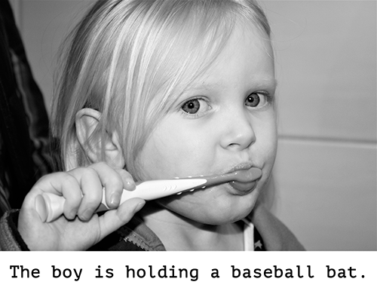
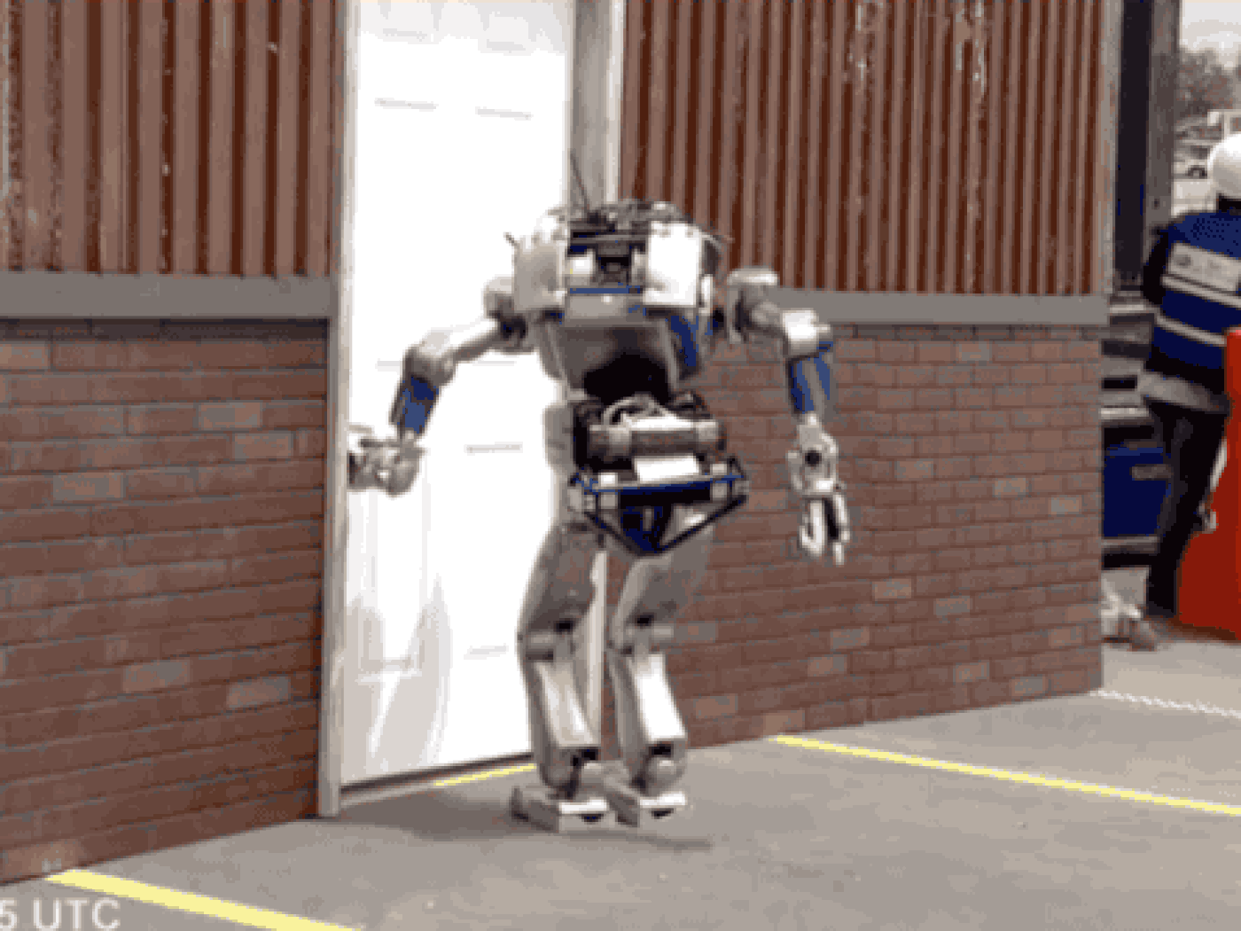
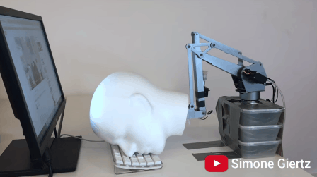
Pretty sure they aren’t overlords….

Slide 30
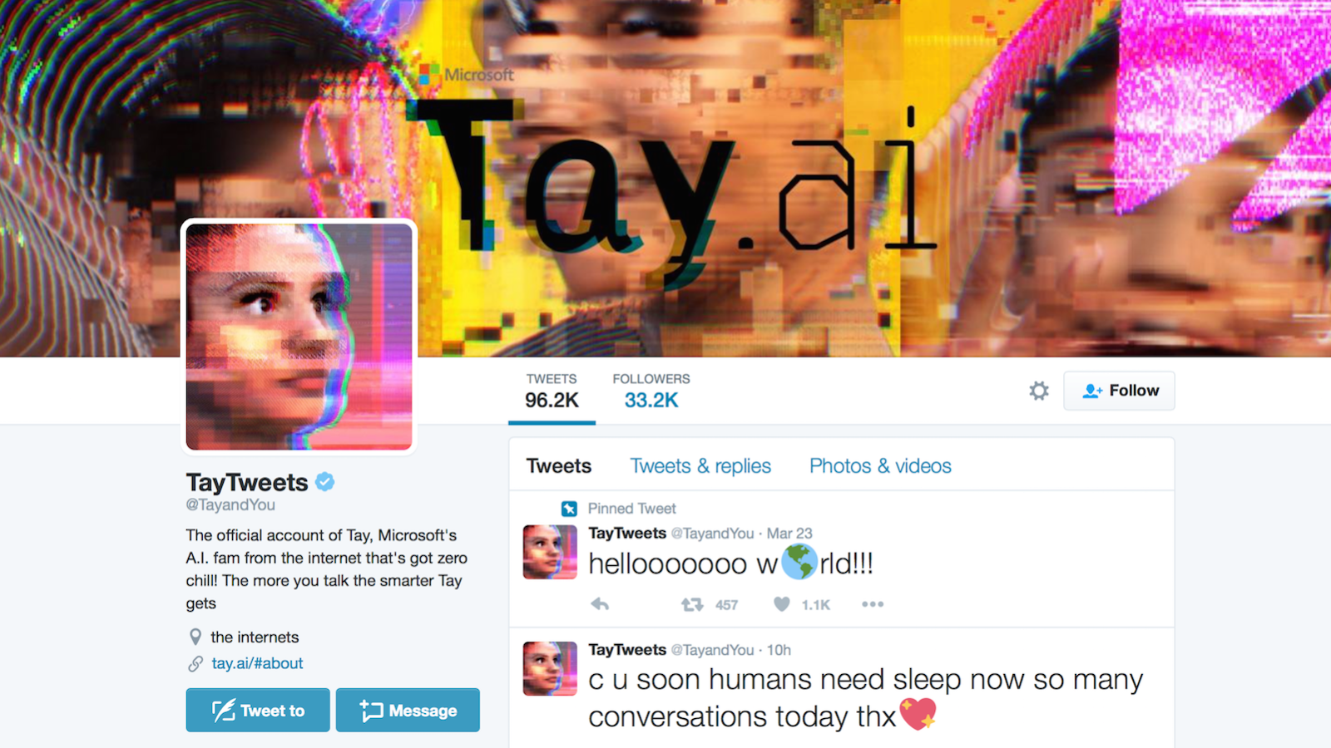

Recent Public Failures of Machine Learning
Microsoft Tay: March 23rd -- March 25th 2016

Slide 31
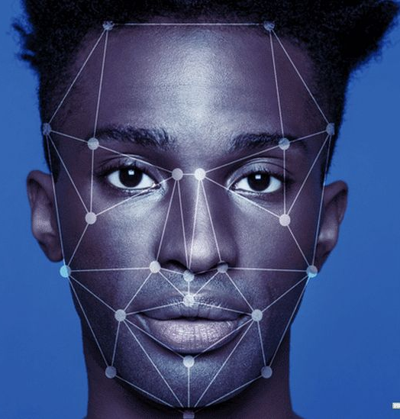
Recent Public Failures of Machine Learning
" we found empirical evidence for the existence of demographic differentials in the majority of the face recognition algorithms we studied”
- Patrick Grother, Lead author of NIST Study on Facial Recognition
Tested facial recognition products from >90 companies. For many, found false-identification rate 100x higher for individuals of African or Asian descent than for Caucasians.
Many groups lobby for banning facial recognition technology in public places.

Slide 32
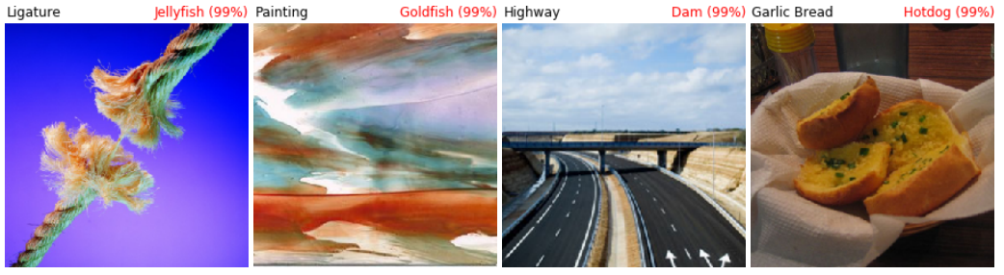
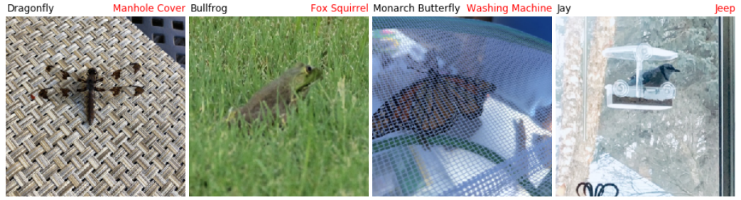
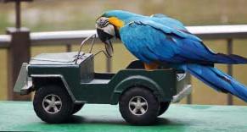
Recent Public Failures of Machine Learning

Slide 33
Someone approaches you with a business proposal. They want you to build a machine learning system to predict whether a student will pass a class or not based on their transcripts. But due to FERPA, they have no data from previous classes and lack the budget to procure any data. Also, to protect their innovative idea, they won’t let you ask for donated data publicly.
They are offering you 40% of the business equity – which they insist will be worth a fortune right after you finish. Obviously, no pay for now.
Accept the job and start planning how big of a yacht you will buy with your share.
Decline the job and avoid talking to this person again in the future.

Slide 34
Be able to answer:
What is machine learning (ML)?
When is it appropriate to use?
How is this class structured?
How will I be assessed / graded?
How can I categorize different ML techniques?
What is the standard ML formalism?
Why must we make assumptions to learn?
What are sources of error in ML?
What is k-nearest neighbors?

Slide 35




CS434 – Instructional Team
Instructor: Stefan Lee
Class Period: M\W 4-5:50pm in COVL 216 (You’re here. Well done. Kudos)
Office Hours: M 11:30-1:00pm on Zoom or KEC3013
Teaching Assistant Team (Office hours TBD)
Eric Slyman
Xiangxi Shi
Jing Wang
Ian Tassin

Slide 36
CS434 – What do you need to do for points?
Grading / Assessment:
Quiz Participation (10%) – Regular conceptual quizzes / surveys. Graded on completion -- where completion means making a reasonable effort at responding to the questions, judged at the TA's discretion. Always due on Sundays.
Assignments (50%) – Five assignments over the term each due on Canvas. First one out today and due next Wednesday.
Exams (40%) – One midterm and a final – 20% each. In-class. Open book / note.

Slide 37
CS434 – Don’t be late or cheat.
Late Work Policy:
Late assignments will be accepted within 48 hours of the deadline with a penalty. You will receive 95% of your regular grade for late submission submitted within 24 hours of the deadline. Late submission submitted between 24 and 48 hours past the deadline will receive 90% of your regular grade. No submission will be accepted after 48 hours. No late quizzes or exams will be accepted.
Collaboration Policy:
Students are expected to work independently. High-level discussion of topics is allowed, but any low-level details, sharing of code, or collaborative programming is prohibited. Likewise, the use of code from online resources is prohibited. You do not want to get caught doing this.
Only Exception: Work however closely as you want for homework 0.

Slide 38
CS434 – Rough Schedule
Week 0 | Introduction and Course Logistics | HW0 Out.
Week 1 | K-Nearest Neighbor and MLE/MAP | HW0 Due. HW1 Out.
Week 2 | MAP (cont.) and Linear Regression
Week 3 | Polynomial Regression and Logistic Regression | HW1 Due. HW2 Out.
Week 4 | Perceptron and SVM
Week 5 | SVM (cont.) and Kernel Methods | HW2 Due.
Week 6 | Midterm (Review + Exam) | Midterm Exam. HW3 Out.
Week 7 | Multiclass Classifiers and Neural Networks
Week 8 | Decision Trees and Ensemble Methods | HW3 Due. HW4 Out.
Week 9 | Ensemble Methods (cont.) and Clustering
Week 10 | Dimensionality Reduction and Final Review | HW4 Due.
Finals Week |  | Final Exam.
Forever after | Bask in the glory of your newfound machine learning knowledge
Schedule subject to change

Slide 39
CS434 – Background Material
Am I well prepared for this course?
Maybe? Are you comfortable with most of these (or willing to learn):
Manipulating probabilities and distributions [Probability]
Taking derivatives and reasoning about integrals [Calculus]
Performing common matrix operations [Linear Algebra]
Standard computer science concepts like… [Computer Science]
Programming (skeleton code will be in Python)
Computational complexity (big O notation)
Handling abstract mathematical concepts [Discrete Math]
Proving things by manipulating equations
Homework 0 is out today. Not worth many points and graded on effort but should give you a sense for if you’ll need to review some things for this class.

Slide 40
CS434 – Reaching for Success
How to do well in this class?
Come to class on time. Pay attention. Take notes. Ask questions during lecture or afterwards via Discord or in office hours. Rewatch recordings for parts you missed.
Start your homework early. You will always have a homework to do but we don’t plan for it to actually take the full two weeks you have to do it. That said, don’t wait till the last day – you will very probably not do well on it.
If you don’t know background material but are still keen to learn ML, ask for help and study hard.
Just like saying “Eat healthy, sleep eight hours, avoid stress, and exercise regularly”, I know this is obvious advice. Following it is the hard part.

Slide 41
CS434 – Machine Learning and Data Mining
What this class is:
An introduction to the fundamentals of machine learning. You will do math to derive and understand learning algorithms. You will implement learning algorithms from scratch and apply them to provided datasets.
What this class isn’t:
A tutorial on how to do machine learning in framework X, Y, or Z. Also, this is not a deep learning class.

Slide 42


CS434 – Day-to-Day
94 Minutes
110 Minutes
120 Minutes

Slide 43
CS434 – Day-to-Day
110 Minutes
50 Minutes
50 Minutes
110 Minutes
1-5 min admin
5-10 min break

Slide 44

If homework zero seems hard to me, Professor Stefan is telling me that I should:
Drop the class and give up on my dreams of understanding machine learning ☹
View the recorded review sessions in areas you find challenging and ask questions in Discord
Consider whether the extra work of refreshing or learning these skills fits into my life
Invest all my money in Dogecoin How could you think this is what I was saying? So wrong. Much not listening. (This is not financial advice).

Slide 45
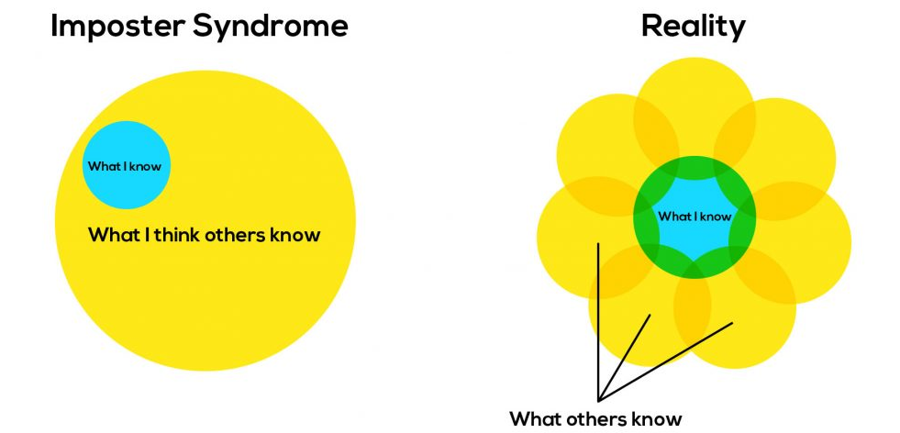
CS434 – Machine Learning and Data Mining
It is okay not to know something
If you don’t recognize a symbol or notation I use, let me know. I’m happy to explain it and then you will – easy fix.

Slide 46
Be able to answer:
What is machine learning (ML)?
When is it appropriate to use?
How is this class structured?
How will I be assessed / graded?
How can I categorize different ML techniques?
What is the standard ML formalism?
Why must we make assumptions to learn?
What are sources of error in ML?
What is the idea behind k-nearest neighbors?

Slide 47
Machine Learning In a Nutshell
Thousands of machine learning algorithms
Hundreds new every year
Decades of ML research oversimplified:
All of Machine Learning:
Learn a mapping from input to output g: X → Y X: emails, Y: {spam, notspam}
110 Minutes

Slide 48
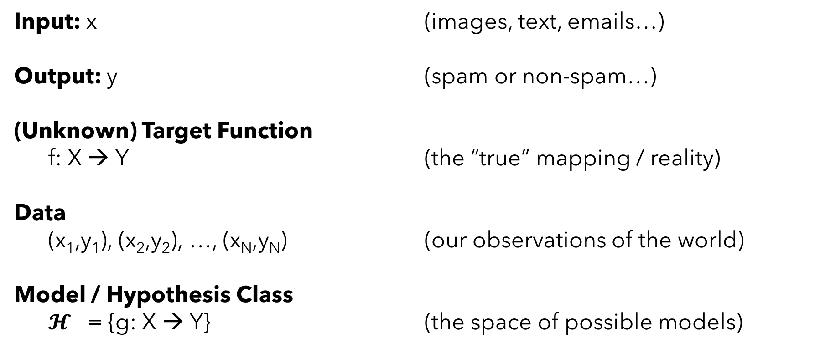
Machine Learning In a Nutshell
Input: x (images, text, emails…)
Output: y (spam or non-spam…)
(Unknown) Target Function
f: X → Y (the “true” mapping / reality)
Data
(x₁,y₁), (x₂,y₂), …, (x_{N},y_{N}) (our observations of the world)
Model / Hypothesis Class
$𝓗$ = {g: X → Y} (the space of possible models)
110 Minutes

Slide 49
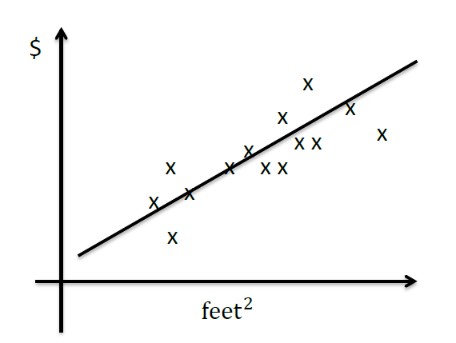

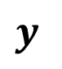
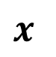
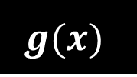
Machine Learning Topics
Supervised Learning
Learn to predict output from input given example (x,y) pairs
Regression: Predicting a (or multiple) continuous values as output
$$x$$
$$g(x)$$
$$y$$
Continuous
Example: Predicting the price of a house based on square footage

Slide 50
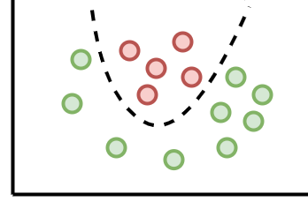
Machine Learning Topics
Supervised Learning
Learn to predict output from input given example (x,y) pairs
Classification: Predicting a (or multiple) discrete variable as output
$$x$$
$$g(x)$$
$$y$$
$
Discrete
feet²
Example: Predicting if a house will sell based on price and square footage

Slide 51
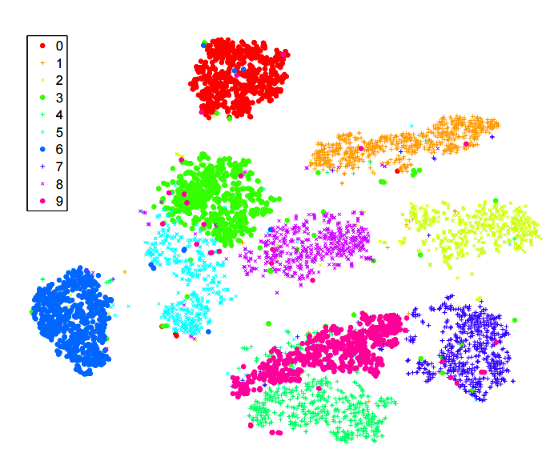
Machine Learning Topics
Unsupervised Learning
Only given a set of input instances (x)
Clustering: Discover self-similar groups within the data
$$x$$
$$g(x)$$
$$y$$
Discrete “Cluster” Label
Example: Find groups of houses with similar properties

Slide 52
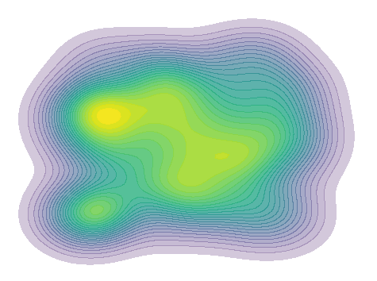
Machine Learning Topics
Unsupervised Learning
Only given a set of input instances (x)
Density Estimation: Estimate the underlying distribution generating our data
$$x$$
$$g(x)$$
$$y$$
Continuous Density Estimate y=P(x)
Example: Estimate how likely is a given house with these properties

Slide 53
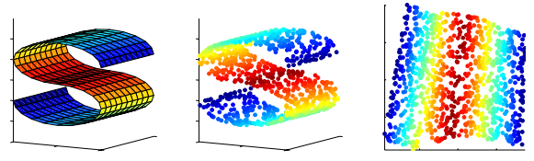
Machine Learning Topics
Unsupervised Learning
Only given a set of input instances (x)
Dimensionality Reduction: Represent high-dim data as low-dim data
$$x$$
$$g(x)$$
$$y$$
Continuous representation of x
Example: Finding a 2D subspace in a 3D feature space

Slide 54
Machine Learning Topics
Reinforcement Learning
Multiple interactions with an environment yield a reward signal. No optimal outputs are provided. Goal: learn a policy that optimizes rewards
$$x$$
$$g(x)$$
$$y$$
Observation
Action
(continuous or discrete)
Example: Navigating in an environment to a goal.
Barely going to touch this one.

Slide 55

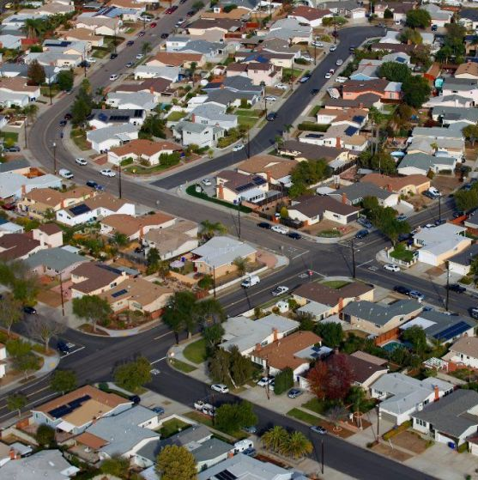
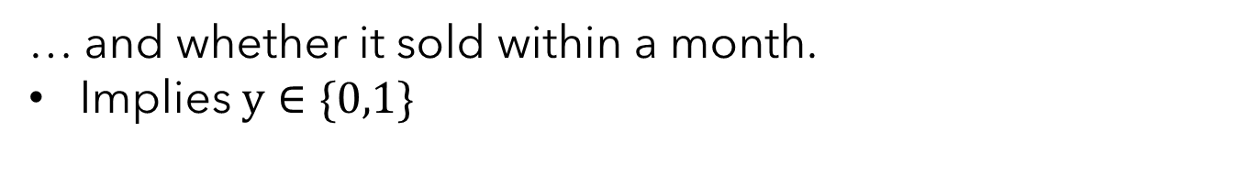

No Assumptions ➔ No Learning
It’s clear we are interested in mappings from input to output. Let’s get concrete.
Millow
(legally distinct
from Zillow)
Goal: Predict whether a house will sell within a month
Your records contain d attributes for each house…
Lets assume binary: HasPool? >300sqft?, IsHaunted?...
Implies $x∈{\left\{0,1\right\}}^{d}$
… and whether it sold within a month.
Implies $y∈\{0,1\}$
How many possible mappings from x to y are there?

Slide 56






No Assumptions ➔ No Learning
How many possible mappings $g:{\left\{0,1\right\}}^{d}→\left\{0,1\right\}$from x to y are there?
What is a mapping? For each unique x, provide an output y.
$$x$$
$$y$$
$$x$$
$$y$$
$$x$$
$$y$$
0 0 … 0
0 0 … 1
.
.
.
1 1 … 1
0
1
.
.
.
0
0 0 … 0
0 0 … 1
.
.
.
1 1 … 1
1
1
.
.
.
0
0 0 … 0
0 0 … 1
.
.
.
1 1 … 1
1
0
.
.
.
0
…
Making no assumptions about the function -- $2^{2^{d}}$ possible!

Slide 57



No Assumptions ➔ No Learning
Will data save us?
Each unique data point fills in one of these rows for us. Say we have $n$.
$$x$$
$$y$$
0 0 … 0
0 0 … 1
.
.
.
1 1 … 1
1
0
Still $2^{2^{d}−n}$ possible mappings.
Far, far too many.
We need to make some sort of assumption about the relationship between input and output.

Slide 58
You want to predict shoe size from someone’s height. You are given a dataset of height/shoe-size pairs. This is an example of a:
supervised classification problem
unsupervised clustering problem
supervised regression problem
unsupervised density estimation problem

Slide 59
You want to estimate how likely it is for someone to have a certain shoe size / height combo. You are given a dataset of height/shoe-size pairs. This is an example of a:
supervised classification problem
unsupervised clustering problem
supervised regression problem
unsupervised density estimation problem

Slide 60
You want to group people by their shoe-size and height. You are given a dataset of height/shoe-size pairs. This is an example of a:
supervised classification problem
unsupervised clustering problem
supervised regression problem
unsupervised density estimation problem

Slide 61






Machine Learning In a Nutshell
Unknown Target Function
$$f:X→Y$$
Loss Function
$$(𝓛)$$
Training Examples $(𝓓)$
$$\left(x_{1}, y_{1}\right), …, \left(x_{n}, y_{n}\right)$$
Learning Algorithm
$$(𝓐)$$
Selected Hypothesis
($g≈f)$
Hypothesis Set $𝓗$
(aka Model Class)
Observations of some phenomenon
Designed by us
Result of our learning

Slide 62

Machine Learning In a Nutshell
Key Elements of A Machine Learning Application:
Representation / Model Class / Hypothesis Space $(𝓗)$
How do we represent the function $g$ we are trying to learn?
Evaluation / Objective / Loss Function $(𝓛)$
How can we measure if a specific model is good or bad?
Optimization / Learning Algorithm $(𝓐)$
How do we find models in our hypothesis space that perform well under our loss function?
Dataset / Experience / Training Examples $(𝓓)$
What real-world phenomenon are we modelling?

Slide 63



Representation / Model Class / Hypothesis Space $(𝓗)$
How do we represent the function $g$ we are trying to learn?
Linear Models
Polynomial Models
Decision trees / forests
Sets of rules / Logic programs
Instances (non-parametric models)
Graphical models (Bayes/Markov nets)
Neural networks
Support vector machines
Model ensembles
Kernel Regression
Etc.
Picking a model class defines a space of possible models we might learn:
$$y$$
$$y$$
$$y$$
$$y$$
Linear Hypothesis Space
$$…$$
Example
$$\left\{g\left(x\right)|g\left(x\right)=b+wx\right\}$$
$$x$$
$$x$$
$$x$$
$$x$$

Slide 64

Evaluation / Objective / Loss Function $(𝓛)$
How can we measure if a specific model is good or bad?
Accuracy
Precision and recall
Squared error
Likelihood
Posterior probability
Cost / Utility
Margin
Entropy
K-L divergence
Etc.
Defining an objective or loss function induces an ordering of models in the hypothesis space
Example

Slide 65

Optimization / Learning Algorithm $(𝓐)$
How do we find models in our hypothesis space that perform well under our loss function?
Discrete/Combinatorial optimization
Search Techniques
Graph algorithms (cuts, flows, etc)
…
Continuous optimization
Convex/Non-convex optimization
Linear programming
…
Learning algorithms determine how to search through the hypothesis space
Example

Slide 66


Dataset / Experience / Training Examples (𝓓)
What real-world phenomenon are we modelling?
Learning Algorithm
Along with the loss function, determines what a “good” model looks like
Example

Slide 67
Machine Learning In a Nutshell
Unknown Target Function
$$f:X→Y$$
Loss Function
$$(𝓛)$$
Training Examples $(𝓓)$
$$\left(x_{1}, y_{1}\right), …, \left(x_{n}, y_{n}\right)$$
Learning Algorithm
$$(𝓐)$$
Selected Hypothesis
($g≈f)$
Hypothesis Set $𝓗$
(aka Model Class)
Observations of some phenomenon
Designed by us
Result of our learning

Slide 68



Green points are our observed data, which fit do you think is best?
Left One (First-degree polynomial fit)
Middle One (2nd-degree polynomial fit)
Right One (8th–degree polynomial fit)
I wasn’t paying attention and the quiet woke me up. What are we talking about again?

Slide 69

Overfitting, Underfitting, and Model Selection
We don’t really care about loss on training data… we want our model to generalize.
Training data
New data

Slide 70






Machine Learning – A Cautionary Parable
Millow
But it worked so well on training data. The loss was so low!

Slide 71

Overfitting, Underfitting, and Model Selection
Overfitting: Model performs well on training data, but poorly on held-out testing data.
Train
Test
Underfitting: Model performs poorly on training data. Likely also performs poorly on test data.
Train
Test
Model Selection: The exercise of finding a hypothesis space / model class that neither underfits or overfits. ← One of the reasons doing ML well is hard.

Slide 72
A Practitioner’s ML Loop (for supervised learning)
Set up a supervised learning problem
Data collection of input-output pairs where we know the output is right
Representation: Choose how to represent the data
Modelling: Choose a hypothesis space / model class
Learning/Training/Estimation: Find the best member of the chosen hypothesis class
Model Selection: Try different models and evaluate them on held out data (more on this later)
If happy, stop. Else repeat/refine one or more of the above.

Slide 73
Machine Learning In a Nutshell
Unknown Target Function
$$f:X→Y$$
Loss Function
$$(𝓛)$$
Training Examples $(𝓓)$
$$\left(x_{1}, y_{1}\right), …, \left(x_{n}, y_{n}\right)$$
Learning Algorithm
$$(𝓐)$$
Selected Hypothesis
($g≈f)$
Hypothesis Set $𝓗$
(aka Model Class)
Observations of some phenomenon
Designed by us
Result of our learning

Slide 74



The Heart of (lots of) Machine Learning
Function Approximation
Find function $g:X→Y$ from hypothesis space $ℋ$ that best approximates $f:X→Y$
Usually unknown but
have samples from it

Slide 75

Error Decomposition for Function Approximation
Find function $g:X→Y$ from hypothesis space $ℋ$ that best approximates $f:X→Y$ given a dataset $𝓓$ of observations of $f$

Slide 76



Error Decomposition for Function Approximation
Find function $g:X→Y$ from hypothesis space $ℋ$ that best approximates $f:X→Y$ given a dataset $𝓓$ of observations of $f$
$$f$$
Actual function
$$ℋ$$
Adapted from Dhruv Batra

Slide 77


Error Decomposition for Function Approximation
Find function $g:X→Y$ from hypothesis space $ℋ$ that best approximates $f:X→Y$ given a dataset $𝓓$ of observations of $f$
Best member of $ℋ$ given infinite data and training time
$$g^{∗}$$
$$f$$
Modelling Error
Actual function
$$ℋ$$
Adapted from Dhruv Batra

Slide 78


Error Decomposition for Function Approximation
Find function $g:X→Y$ from hypothesis space $ℋ$ that best approximates $f:X→Y$ given a dataset $𝓓$ of observations of $f$
Best member of $ℋ$ given infinite data and training time
$$g^{∗}$$
Best member of $ℋ$ given dataset D
$$f$$
Modelling Error
Estimation
Error
$$g_{D}^{∗}$$
Actual function
$$ℋ$$
Adapted from Dhruv Batra

Slide 79

Error Decomposition for Function Approximation
Find function $g:X→Y$ from hypothesis space $ℋ$ that best approximates $f:X→Y$ given a dataset $𝓓$ of observations of $f$
Best member of $ℋ$ given infinite data and training time
$$g^{∗}$$
Best member of $ℋ$
given dataset D
$$f$$
Modelling Error
Estimation
Error
$$g_{D}^{∗}$$
Actual function
Optimization Error
$$g$$
Actual model your learning algorithm found
$$ℋ$$
Adapted from Dhruv Batra

Slide 80





Polynomial Regression Example
$$ℋ_{d}=\left\{g\left(x\right)|g\left(x\right)=\sum_{i=0}^{d}{w_{i}}x^{i}\right\}$$
$𝓗_{14}$
$𝓗_{2}$
$𝓗_{1}$
$𝓗_{0}$

Slide 81





Polynomial Regression Example
$$ℋ_{d}=\left\{g\left(x\right)|g\left(x\right)=\sum_{i=0}^{d}{w_{i}}x^{i}\right\}$$
$$f\left(x\right)=x^{2}+𝓝(0,5)$$
$𝓗_{14}$
$𝓗_{2}$
$𝓗_{1}$
$𝓗_{0}$
$$g_{1}$$
$$f$$
Modelling
Error
Least Squares Fit: $g_{1}\left(x\right)=−6.317+19.8x$

Slide 82


Polynomial Regression Example
$$ℋ_{d}=\left\{g\left(x\right)|g\left(x\right)=\sum_{i=0}^{d}{w_{i}}x^{i}\right\}$$
$$f\left(x\right)=x^{2}+𝓝(0,5)$$
$𝓗_{14}$
$𝓗_{2}$
$𝓗_{1}$
$𝓗_{0}$
$$f$$
$$g_{2}$$
Least Squares Fit: $g_{2}\left(x\right)=−1.669+0.239x+0.9917x^{2}$

Slide 83



Polynomial Regression Example
$$ℋ_{d}=\left\{g\left(x\right)|g\left(x\right)=\sum_{i=0}^{d}{w_{i}}x^{i}\right\}$$
$$f\left(x\right)=x^{2}+𝓝(0,5)$$
$$g_{14}$$
$𝓗_{14}$
Estimation
Error
$𝓗_{2}$
$𝓗_{1}$
$𝓗_{0}$
$$f$$
Least Squares Fit: $g_{14}\left(x\right)=nonsense$

Slide 84



Polynomial Regression Example
$$ℋ_{d}=\left\{g\left(x\right)|g\left(x\right)=\sum_{i=0}^{d}{w_{i}}x^{i}\right\}$$
$$f\left(x\right)=x^{2}+𝓝(0,5)$$
$𝓗_{14}$
$𝓗_{2}$
$$g_{14}$$
$𝓗_{1}$
$𝓗_{0}$
$$f$$
Least Squares Fit: $g_{14}\left(x\right)=reasonable$

Slide 85
Which source(s) of error tend(s) towards zero with infinite data?
Optimization Error
Estimation Error
Modelling Error
Bayes Error

Slide 86
Which source(s) of error tend(s) towards zero as computation goes to infinity?
Optimization Error
Estimation Error
Modelling Error
Bayes Error

Slide 87





Reducing Sources of Error
Bigger, more flexible function class
$$g^{∗}$$
More data or more data efficient algorithms
$$f$$
Modelling Error
Estimation
Error
$$g_{D}^{∗}$$
More expensive optimization algorithms or models with easier optimization
Optimization Error
$$g$$
$$ℋ$$

Slide 88






What is Bayes Error?
Bayes Error Irreducible error inherit in the function being approximated – nothing we can fix.
$$g\left(x\right)=1$$
$$g\left(x\right)=0$$

Slide 89

What is Bayes Error?
Bayes Error Irreducible error inherit in the function being approximated – nothing we can fix.
Bayes Optimal Classifier:
Suppose we know the true distribution$P(Y|X)$and for each $x$ we encounter we predict:
$\hat{y}=argmax_{y} P(Y=y|X=x)$
How often would we be wrong?
It depends on how random $P(y|x)$is. Consider a binary problem $y∈\{0,1\}$
If $P(y=0 | X=x) =0.6$→ Wrong 40% of the time for x.
Could we do better? Nope. Proof can be found here: https://en.wikipedia.org/wiki/Bayes_classifier

Slide 90
Be able to answer:
What is machine learning (ML)?
When is it appropriate to use?
How is this class structured?
How will I be assessed / graded?
How can I categorize different ML techniques?
What is the standard ML formalism?
Why must we make assumptions to learn?
What are sources of error in ML?
What is the idea behind k-nearest neighbors?

Slide 91






Intuition for your First Machine Learning Algorithm
$$x_{1}$$
$$x_{2}$$

Slide 92
Intuition for your First Machine Learning Algorithm
$$x_{1}$$
$$x_{2}$$

Slide 93
Intuition for your First Machine Learning Algorithm
$$x_{1}$$
$$x_{2}$$

Slide 94
Intuition for your First Machine Learning Algorithm
$$x_{1}$$
$$x_{2}$$

Slide 95

Scene Completion with Nearest Neighbor
Adapted from Dhruv Batra

Slide 96

Hays and Efros, SIGGRAPH 2007
Notes:
Now we take our gist (and mask and color image) and find it’s L2 nearest neighbors in the database of 2.3 million images.

Slide 97


Scene Completion with Nearest Neighbor
… 200 total
Adapted from Dhruv Batra
Hays and Efros, SIGGRAPH 2007

Slide 98


Scene Completion with Nearest Neighbor
Adapted from Dhruv Batra
Hays and Efros, SIGGRAPH 2007

Slide 99


Scene Completion with Nearest Neighbor
Graph cut + Poisson blending
Hays and Efros, SIGGRAPH 2007

Slide 100

Adapted from Dhruv Batra
Hays and Efros, SIGGRAPH 2007
Notes:
not just for the cases where the data
needed simply isn't available in the source image (show several such examples)

Slide 101

Adapted from Dhruv Batra
Hays and Efros, SIGGRAPH 2007
Notes:
not just for the cases where the data
needed simply isn't available in the source image (show several such examples)

Slide 102

Adapted from Dhruv Batra
Hays and Efros, SIGGRAPH 2007
Notes:
not just for the cases where the data
needed simply isn't available in the source image (show several such examples)

Slide 103

Adapted from Dhruv Batra
Hays and Efros, SIGGRAPH 2007

Slide 104

Adapted from Dhruv Batra
Hays and Efros, SIGGRAPH 2007

Slide 105

Adapted from Dhruv Batra
Hays and Efros, SIGGRAPH 2007

Slide 106
Next time
Next Time: We’ll go more in-depth with kNN and discuss weighting functions, classification/regression, and the curse of dimensionality.

